Slide 1













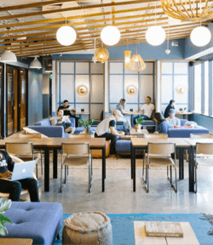

E-GOV SIMPLIFY (Business prOcess Framework)
Developed By:
DEVANG SHARMA
devangs@cisco.com

Slide 2

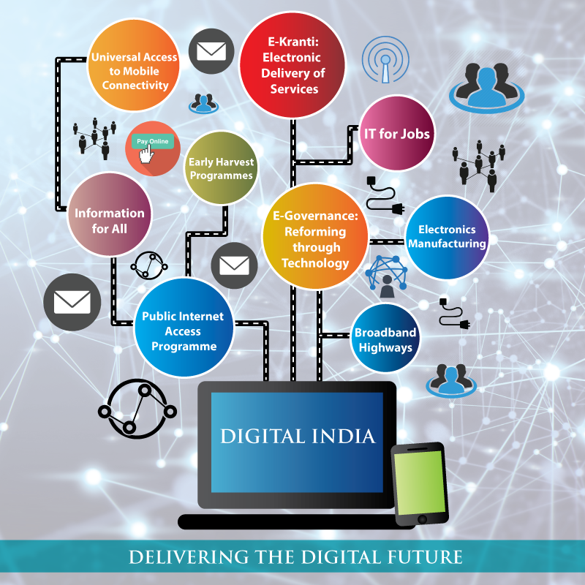
BIG GOAL
BIG GOAL
BIG GOAL
Brief Description of this goal
Brief Description of this goal
Brief Description of this goal
BIG GOAL
BIG GOAL
Brief Description of this goal
Brief Description of this goal
BIG GOAL
Brief Description of this goal

Slide 3

TABLE OF CONTENTS
BACKGROUND
PRODUCT OVERVIEW
01
04
WHAT ARE INTERMEDIARIES?
PROJECT TIMELINE
02
05
CONTEXT
CONTACT US
03
06

Slide 4

BACKGROUND
Digitization initiatives have a good intention to simplify the process and to save time for Employees and Citizens. However, sometimes it does backfire due to lack of homework and lack of thoughts on Business Process Optimization. Many times adoption of such digital initiatives is low due to lower quality of user experience and broken business process flow compared to the reality on the ground.

Slide 5


PROJECT TIMELINE
FEB 2021
MAR-APR 2021
LIVE DEMO AVAILABLE
DEPLOYMENT AFTER TESTING

Slide 6
WHAT ARE business prOCESS FRAMEWORKS?
The Business Process Framework (eTOM) is a critical component of the Open Digital Framework, TM Forum’s blueprint for enabling successful business transformation.
It is a comprehensive, industry-agreed, multi-layered view of the key business processes required to run an efficient, effective and agile digital enterprise.
All of the Open Digital Framework, including the Business Process Framework, is created and evolved by industry leaders and practitioners in TM Forum’s member driven collaboration community.

Slide 7
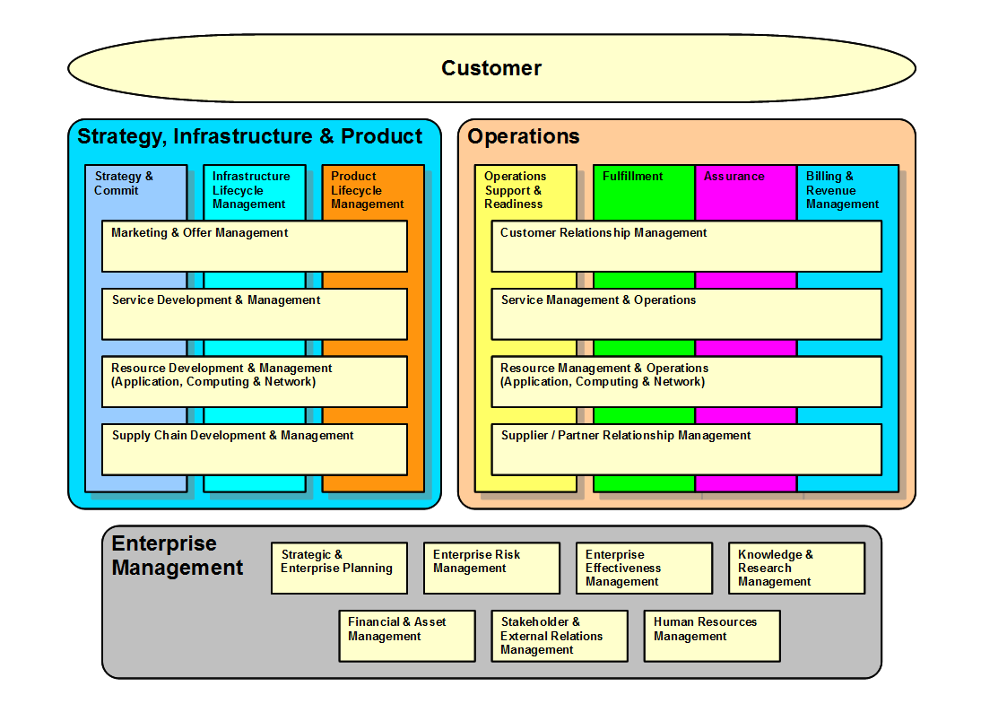
Advantages of DIGITAL TRANSFORMATIOn

Slide 8
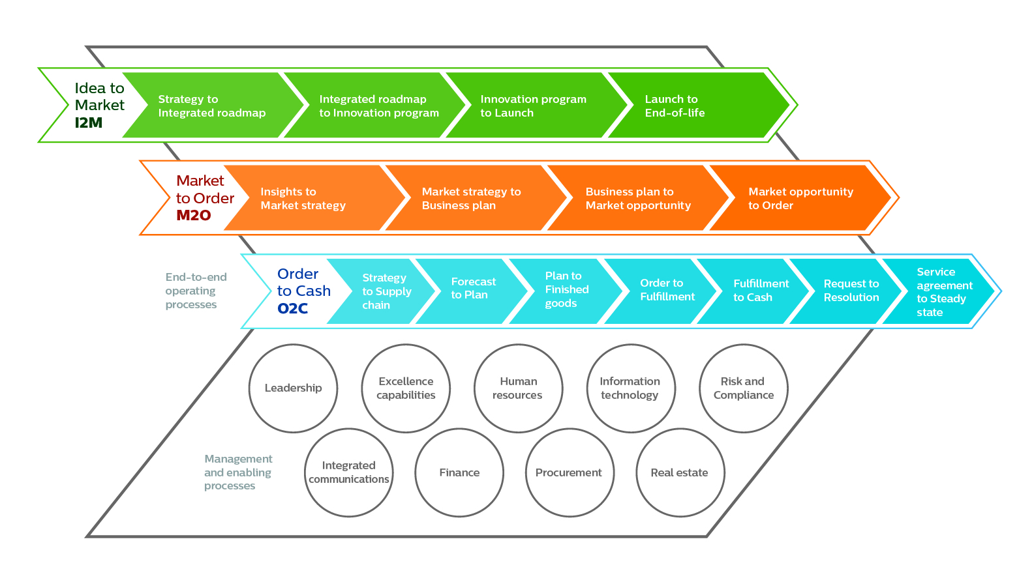
PERFORMANCE
AGAINST SCHEDULE
Milestone | Scheduled Completion Date | Actual Completion Date | Difference
Milestone Name | 10/04 | 10/05 | 1 Day Late
Milestone Name | 04/21 | 04/21 | On Time
Milestone Name | 01/13 | 01/09 | 4 Days Early
Milestone Name | 04/24 | 03/13 | 6 Weeks Early
Milestone Name | 05/25 | 05/30 | 5 Days Late
Milestone Name | 09/22 | 09/23 | 1 Day Late
Project Completion | 12/04 | 12/11 | 1 Week Late

Slide 9
CONTEXt
On the eGov DIGIT platform, many citizen services are enabled in the self serve mode (Portal, Mobile, WhatsApp).
The eGov DIGIT Platform has multiple services offered to Citizens and ULB employees. These services have evolved over a period of time based on the feedback from the field. There is a scope to improve further from the user experience and Business Process Optimization point of view.

Slide 10
HOW BUSINESS PROCESS HELP?
To maintain an exhaustive dataset for future analytics and reporting purposes, people tend to capture more information during application submission. Long forms in the Products like Faecal Sludge Management, Water & Sewerage, Fire NOC, Building Plan Approval, Property Tax etc are some examples. Long forms are one of the reasons for lower digital adoption while in the Government System these details might already be there for the same person for some other Government Service but never get reused due to lack of convergence in the departments and lack of horizontal stack in the digital solution.
Another example is the Field Verification Process. While digitizing business processes, people convert the existing process of field visit into digital solution without any recommendation of alternate approaches. For example can the field verification be done remotely with the help of technology like video call verification, OTP based scanned doc submission from the field, video KYC etc are some good examples and ULB employees can be more productive. They might be required to go to the field in exceptional cases only.

Slide 11
HOW BUSINESS PROCESS HELP? (Contd.)
One more example is while digitizing, people tend to convert all steps into the Workflow while the ground reality may be different. A Cashier may not have a computer at his/her counter as his/her job is to just collect the cash while in the application process collection process is part of digitization, how will a person without a computer at his counter close that step in workflow?
Another example is Meter reading and door to door collection. There is a possibility that field executive visits the places where there is no internet connection and in the digital solution there is no way to work offline for the field employee. Such scenarios need to be thought through while digitising the process. SMS reminders even after the payment is done is one more example of poor user experience in digitisation.
Few more examples of recommendation approaches are: while digitizing the process, creating incentives for Citizens for better digital adoptions like rebate for opting paperless bills, rebate for immediate payment at the time of meter reading etc.

Slide 12
BIG GOAL
BIG GOAL
BIG GOAL
Brief Description of this goal
Brief Description of this goal
Brief Description of this goal
BIG GOAL
BIG GOAL
Brief Description of this goal
Brief Description of this goal
BIG GOAL
Brief Description of this goal

Slide 13
PRODUCT OBJECTIVES
Mailers
Email
Designd a Business Process Framework for Government Services which are available on DIGIT (https://www.digit.org/)
CONSIDERATIONS
End to end proposal for the module picked by you.
Proposal should cover the alternate approaches for existing workflows for simplification.
Proposal should cover the approach to capture minimalistic information from Citizens and how to reuse the existing information with the Government.
Proposal should cover the approach on how to keep the PII data safe during digitisation.
Social Media
LinkedIn
Facebook
Banner Ads
TV Ads

Slide 14



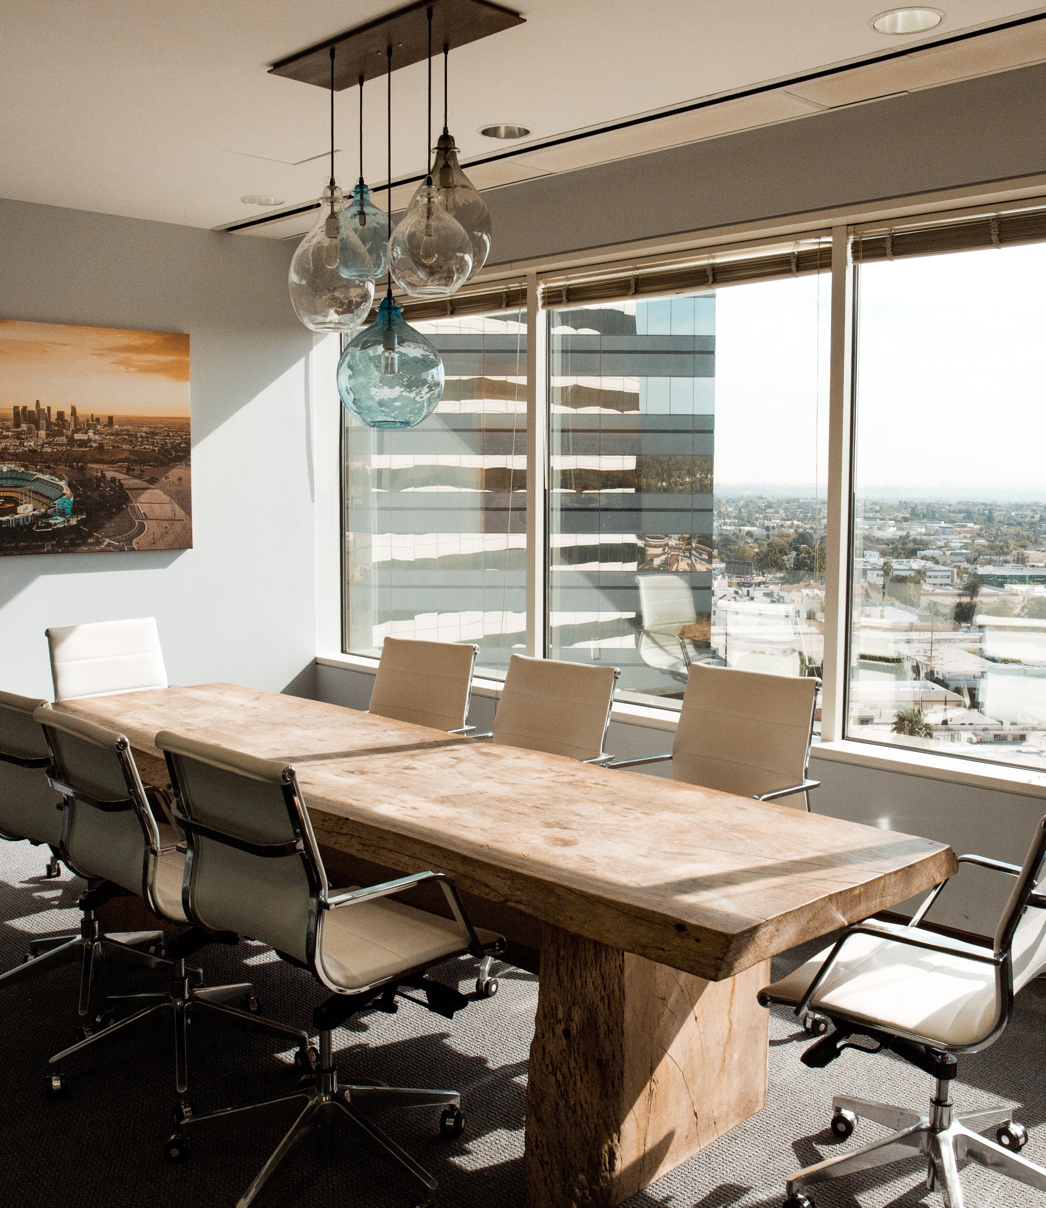
NEXT STEPS
Step Three
Step One
Step Two
Working Protoptype for E-GOV Business Process Framework
Step Four
Step Five
Clarified Product Requirements and Analysis
Developed Prototype With Required Specifications
Testing and Deployment using DIGIT Tech Stack
Serve the Website to the Public Users

Slide 15

SOURCE CODE
GITHUB
https://github.com/Devang-25/E-Government-Simplify-By-Devang-Sharma
Phone | +91-9953027469
Email | devangs@cisco.com

Slide 16

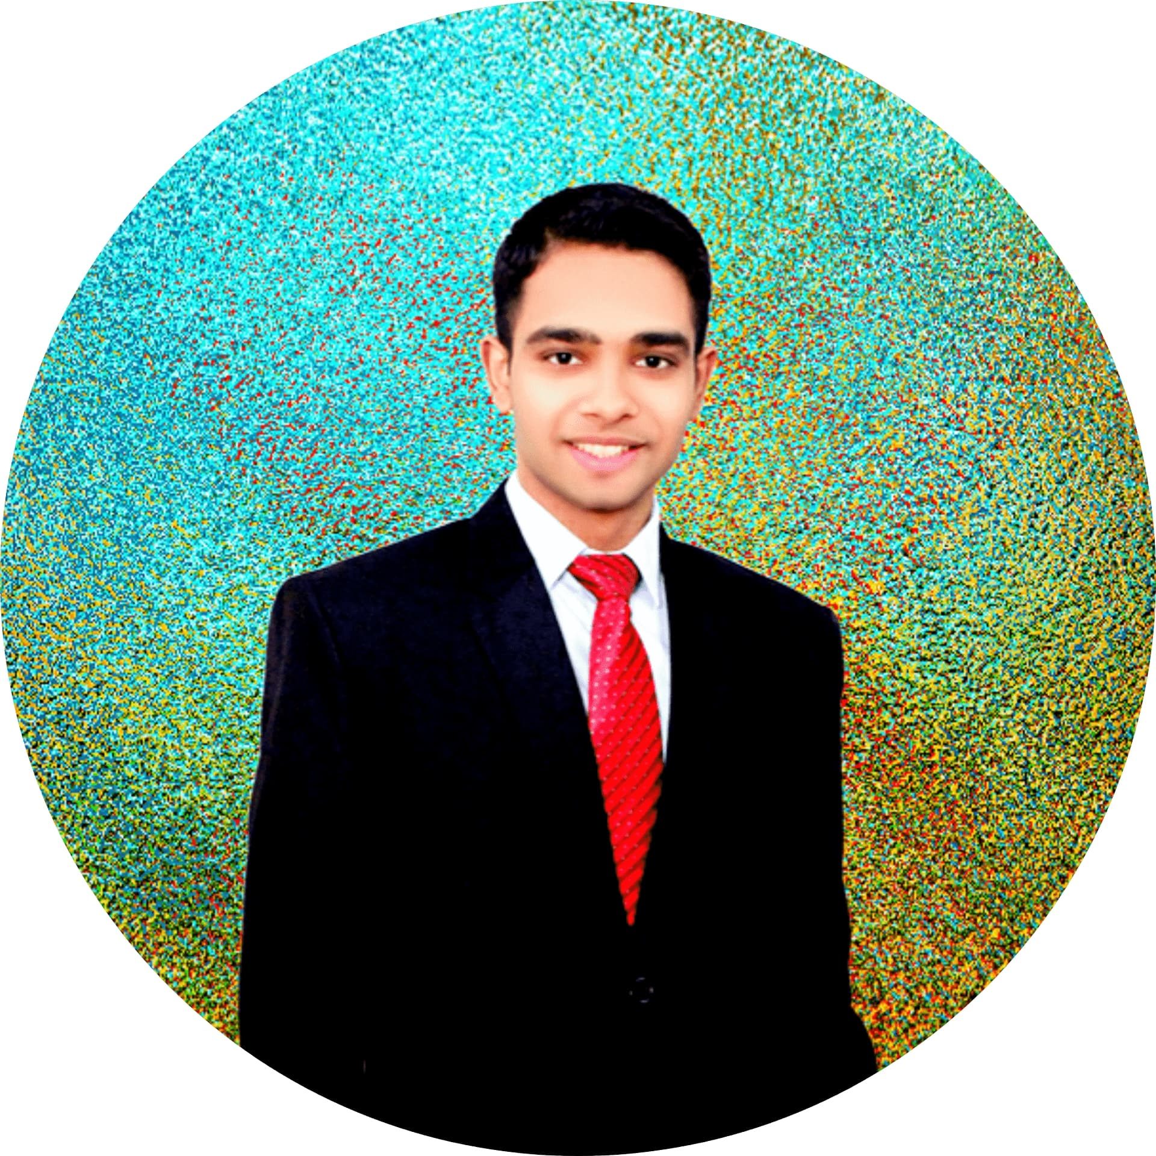
MEET THE TEAM
DEVANG SHARMA
Senior Software Developer At CISCO
devangs@cisco.com
Linkedin: https://www.linkedin.com/in/devang25/

